Slide 1
Chapter 6: Sampling and Estimation
Business Analytics, 1st edition
James R. Evans

Slide 2
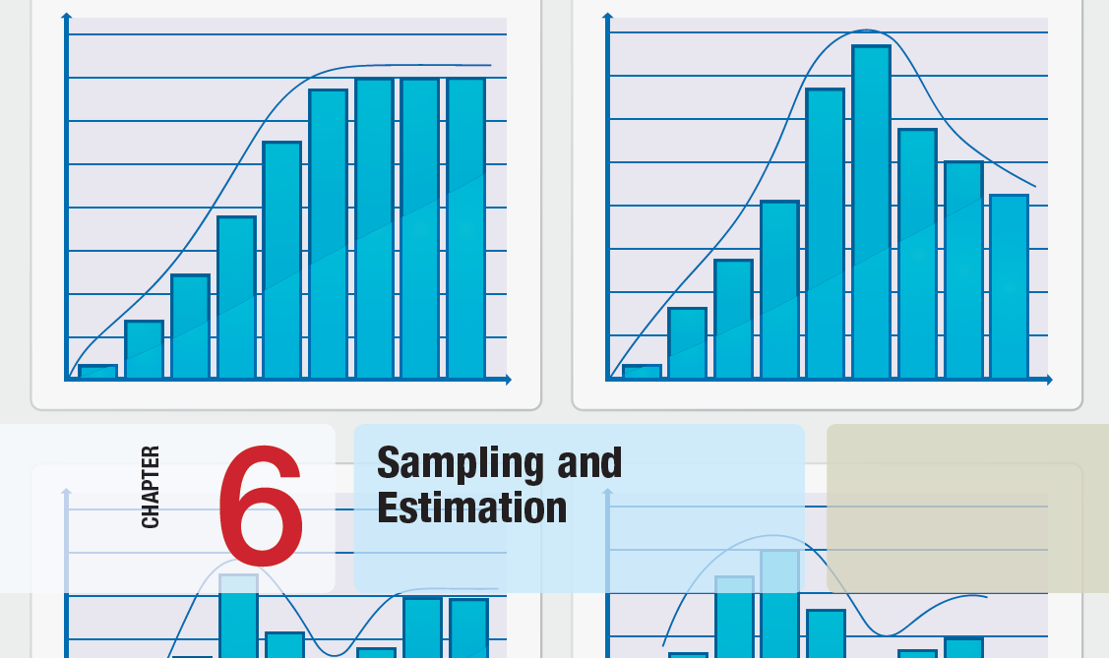

Slide 3
Chapter 6 Topics
Statistical Sampling
Estimating Population Parameters
Sampling Error
Sampling Distributions
Interval Estimates
Confidence Intervals
Using Confidence Intervals for Decision Making
Prediction Intervals
Confidence Intervals and Sample Size

Slide 4
Statistical Sampling
Sampling is the foundation of statistical analysis.
Sampling plan - a description of the approach that is used to obtain samples from a population
A sampling plan states:
- its objectives
- target population
- population frame
- operational procedures for data collection
- statistical tools for data analysis

Slide 5
Statistical Sampling
Example 6.1 A Sampling Plan for a Market Research Study
A company wants to understand how golfers might respond to a membership program that provides discounts at golf courses.
Specify 5 components for a sampling plan.

Slide 6
Statistical Sampling
Example 6.1 (continued)
A Sampling Plan for a Market Research Study
Objective - estimate the proportion of golfers who would join the program
Target population - golfers over 25 years old
Population frame - golfers who purchased equipment at particular stores
Operational procedures - e-mail link to survey or direct-mail questionnaire
Statistical tools - PivotTables to summarize data by demographic groups and estimate likelihood of joining the program

Slide 7
Statistical Sampling
Sampling Methods
Subjective Methods
- judgment sampling
- convenience sampling
Probability Sampling
- simple random sampling
involves selecting items from a population so that every subset of a given size has an equal chance of being selected

Slide 8
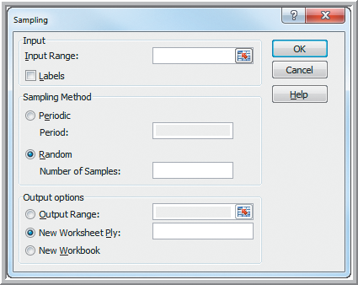
Statistical Sampling
Example 6.2 Simple Random Sampling with Excel
Sample from the
Excel database
Sales Transactions
Data
Data Analysis
Sampling
Periodic selects every n^{th} number
Random selects a simple random sample
Figure 6.1

Slide 9
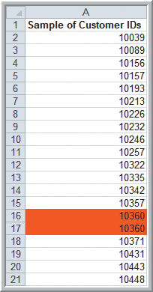
Statistical Sampling
Example 6.2 (continued)
Simple Random Sampling with Excel
Samples generated by Excel
Sorted by customer ID
Sampling is done with replacement so duplicates may occur.
Figure 6.2

Slide 10
Statistical Sampling
Additional Probability Sampling Methods
- Systematic (periodic) sampling
- Stratified sampling
- Cluster sampling
- Sampling from a continuous process

Slide 11
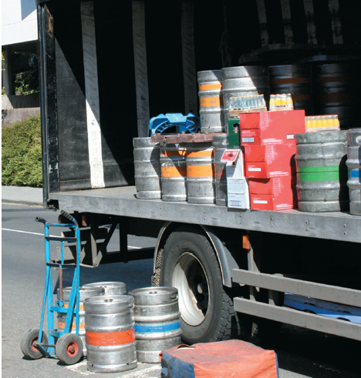
Statistical Sampling
Analytics in Practice: Using Sampling
Techniques to Improve Distribution
MillerCoors brewery wanted to better understand distributor performance
Defined 7 attributes of proper distribution
Collected data from distributors using stratified sampling based on market share
Developed performance rankings of distributors and identified opportunities for improvement

Slide 12
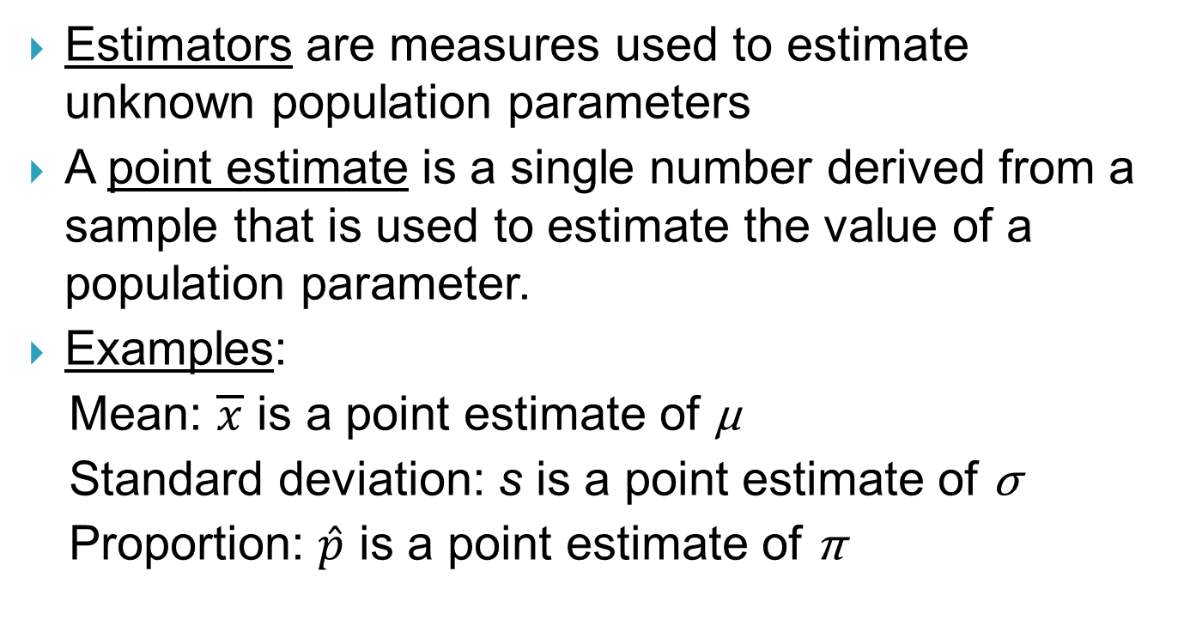
Estimating Population Parameters

Slide 13


Estimating Population Parameters
Unbiased Estimators - the expected value of the estimator equals the population parameter
Using n − 1 in the denominator of the sample variance s² results in an unbiased estimator of σ².
is an unbiased
estimator of

Slide 14
Sampling Error
Sampling (statistical) error occurs because samples are only a subset of the total population
Sampling error depends on the size of the sample relative to the population.
Nonsampling error occurs when the sample does not adequately represent the target population.
Nonsampling error usually results from a poor sample design or choosing the wrong population frame.

Slide 15
Sampling Error
Example 6.3 A Sampling Experiment
A population is uniformly distributed between 0 and 10.
Mean = (0 + 10)/2 = 5
Variance = (10 − 0)²/12 = 8.333
Use Excel to generate 25 samples of size 10 from this population. Compute the mean of each.
Prepare a histogram of the 25 sample means.
Prepare a histogram of the 250 observations.

Slide 16
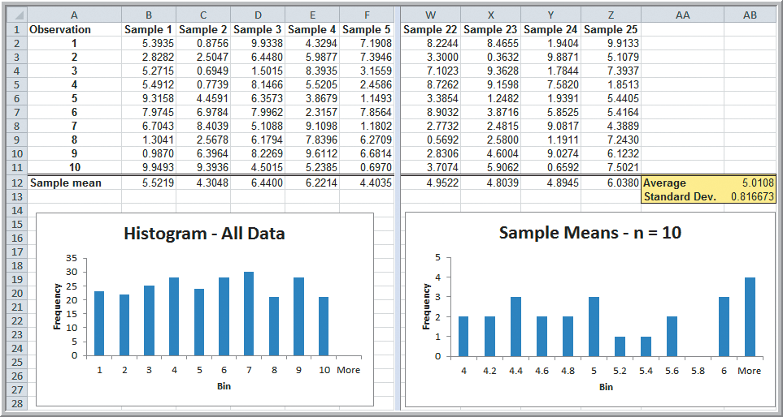
Sampling Error
Example 6.3 (continued) A Sampling Experiment
Figure 6.3

Slide 17
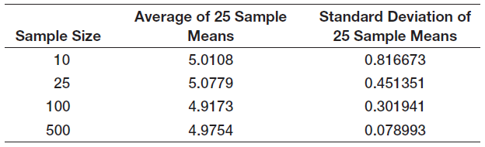
Sampling Error
Example 6.3 (continued) A Sampling Experiment
Repeat the sampling experiment for samples of size 25, 100, and 500
Table 6.1

Slide 18
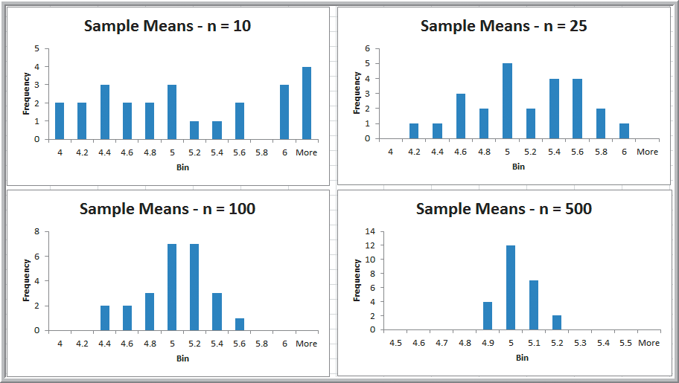
Sampling Error
Example 6.3 (continued) A Sampling Experiment
Figure 6.4

Slide 19
Sampling Error
Example 6.4 Estimating Sampling Error Using the Empirical Rules
Using the empirical rule for 3 standard deviations away from the mean, ~99.7% of sample means should be between:
[2.55, 7.45] for n = 10
[3.65, 6.35] for n = 25
[4.09, 5.91] for n = 100
[4.76, 5.24] for n = 500
Table 6.1

Slide 20
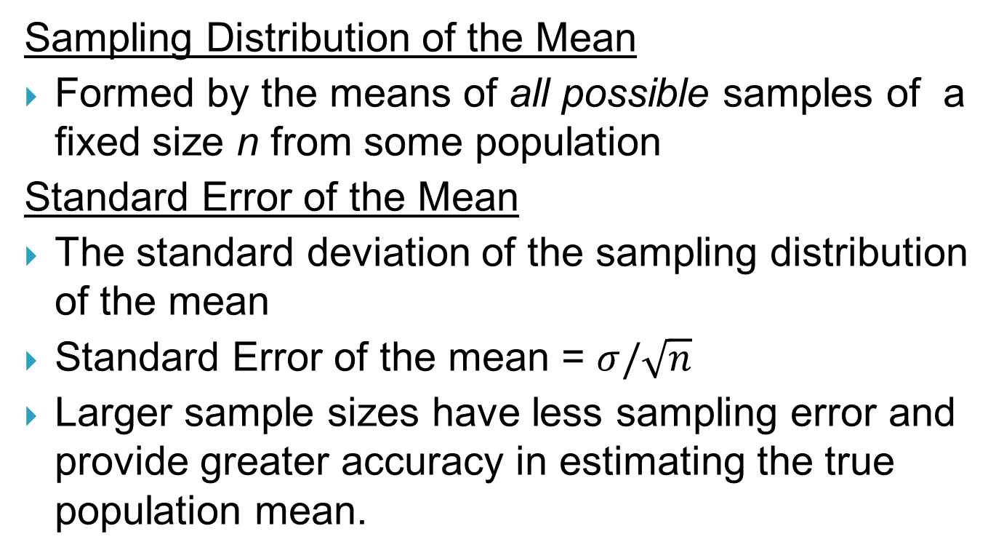
Sampling Distributions

Slide 21
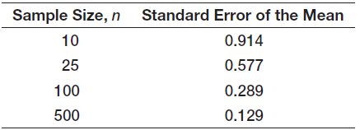
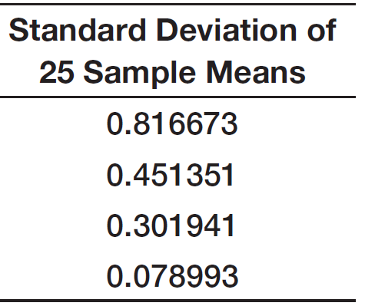
Sampling Distributions
Example 6.5
Computing the Standard Error of the Mean
For the uniformly distributed population, we found ² = 8.333 and, therefore,  = 2.89
Compute the standard error of the mean for sample sizes of 10, 25, 100, 500.
For comparison from Table 6.1

Slide 22
Sampling Distributions
Central Limit Theorem
If the sample size is large enough, then the sampling distribution of the mean is:
- approximately normally distributed regardless
of the distribution of the population
- has a mean equal to the population mean
If the population is normally distributed, then the sampling distribution is also normally distributed for any sample size.
This theorem is one of the most important practical results in statistics.

Slide 23
Sampling Distributions
Example 6.6
Using the Standard Error in Probability Calculations
The purchase order amounts for books on a publisher’s Web site is normally distributed with a mean of $36 and a standard deviation of $8.
Find the probability that:
a) someone’s purchase amount exceeds $40
b) the mean purchase amount for 16 customers
exceeds $40

Slide 24
Sampling Distributions
Example 6.6 (continued)
Using the Standard Error in Probability Calculations
a) P(x > 40) = 1− NORM.DIST(40, 36, 8, true)
= 0.3085
b) P(x > 40) = 1− NORM.DIST(40, 36, 2, true)
= 0.0228
−

Slide 25
Interval Estimates
Example 6.7 Interval Estimates in the News
A Gallup poll might report that 56% of voters support a certain candidate with a margin of error of ± 3%.
We would have a lot of confidence that the candidate would win.
If, instead, the poll reported a 52% level of support with a ± 4% margin of error, we would be less confident in predicting a win for the candidate.

Slide 26
Confidence Intervals
Interval Estimates
Provide a range for a population characteristic based on a sample.
A confidence interval of 100(1 − α)% is an interval [A, B] such that the probability of falling between A and B is 1− α.
1− α is called the level of confidence.
90%, 95%, and 99% are common values for 1− α.
Confidence intervals provide a way of assessing the accuracy of a point estimate.

Slide 27

Confidence Intervals
Confidence Interval For the Mean with
Known Population Standard Deviation
Sample mean ± margin of error
Sample mean ± z_{α/2} (standard error)
where z_{α/2} is the value of the standard normal random variable for an upper tail area of α/2 (or a lower tail area of 1 − α/2).

Slide 28
Confidence Intervals
Example 6.8 Computing a Confidence Interval with a Known Standard Deviation
A production process fills bottles of liquid detergent.
The standard deviation in filling volumes is constant at 15 mls.
A sample of 25 bottles revealed a mean filling volume of 796 mls.
Give a 95% confidence interval estimate of the mean filling volume for the population.

Slide 29
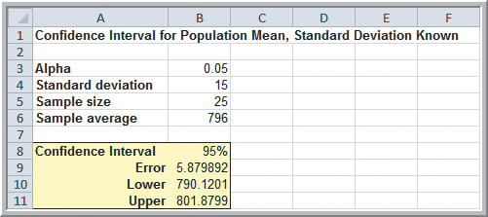
Confidence Intervals
Example 6.8 (continued) Computing a Confidence Interval with a Known Standard Deviation
= Mean ± CONFIDENCE.NORM(alpha, stdev, size)
= 796 ± CONFIDENCE.NORM(.05, 15, 25)
Figure 6.5

Slide 30
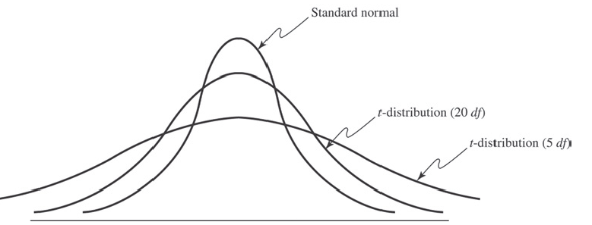
Confidence Intervals
The t-Distribution
Used for confidence intervals when the population standard deviation in unknown.
Its only parameter is the degrees of freedom (df).
Figure 6.6

Slide 31

Confidence Intervals
Confidence Interval for a Population Mean with an Unknown Standard Deviation
Sample mean ± margin of error
Sample mean ± t_{α/2} (estimated standard error)
where t_{α/2} is the value of the t-distribution with
df = n − 1 for an upper tail area of α/2.
t values are found in Table 2 of Appendix B.

Slide 32
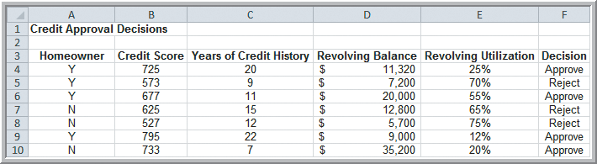
Confidence Intervals
Example 6.9 Computing a Confidence Interval with an Unknown Standard Deviation
A large bank has sample data used in making credit decisions.
Give a 95% confidence interval estimate of the mean revolving balance of homeowner applicants.
Figure 6.7

Slide 33
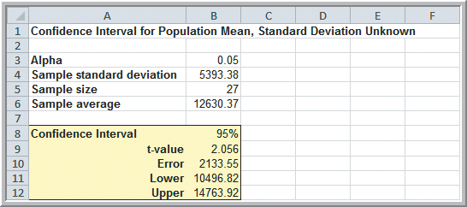
Confidence Intervals
Example 6.9 (continued) Computing a Confidence Interval with an Unknown Standard Deviation
= Mean ± T.INV(confidence level, df)*s/SQRT(n)
= Mean ± CONFIDENCE.T(alpha, stdev, size)
Figure 6.8

Slide 34
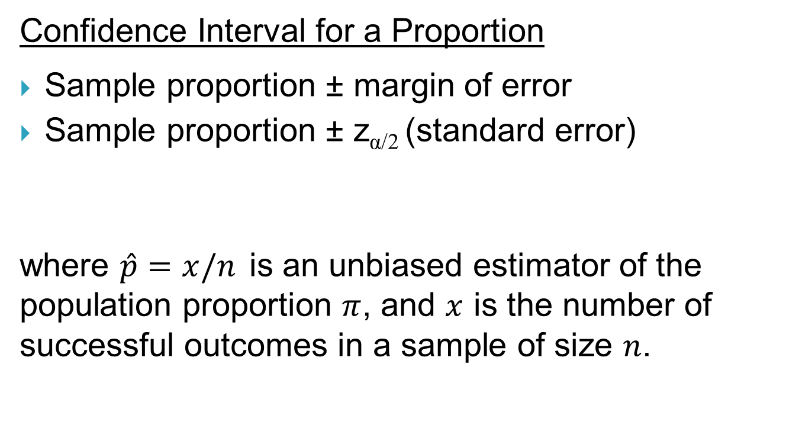

Confidence Intervals

Slide 35
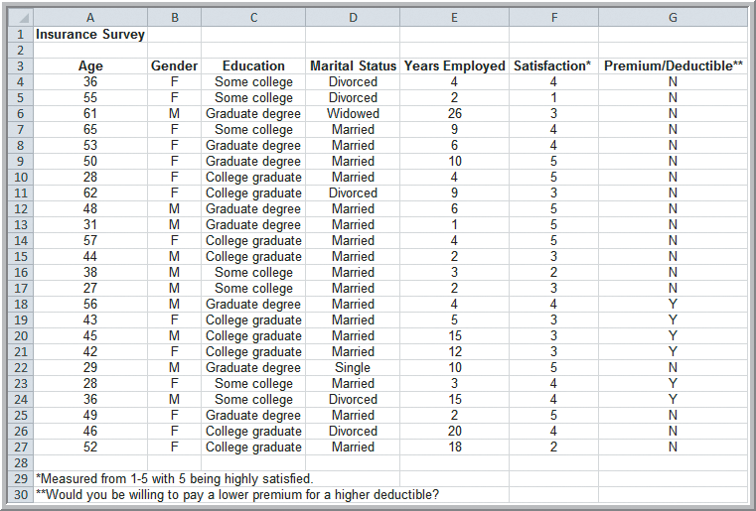
Confidence Intervals
Example 6.10 Computing a Confidence Interval for a Proportion (of those willing to pay a lower health insurance premium for a lower deductible)
Figure 6.9

Slide 36
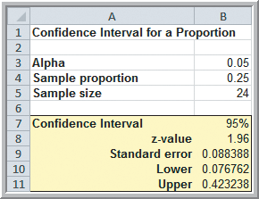
Confidence Intervals
Example 6.10 (continued) Computing a 95% Confidence Interval for a Proportion
Sample proportion ± NORM.S.INV((alpha/2)*
(standard error of the sample proportion))
Figure 6.10

Slide 37
Using Confidence Intervals for Decision Making
Example 6.11 Drawing a Conclusion about a Population Mean Using a Confidence Interval
In Example 6.8 we obtained a confidence interval for the bottle-filling process as [790.12, 801.88]
The required volume is 800 and the sample mean is 796 mls.
Should machine
adjustments be
made?
Figure 6.5

Slide 38
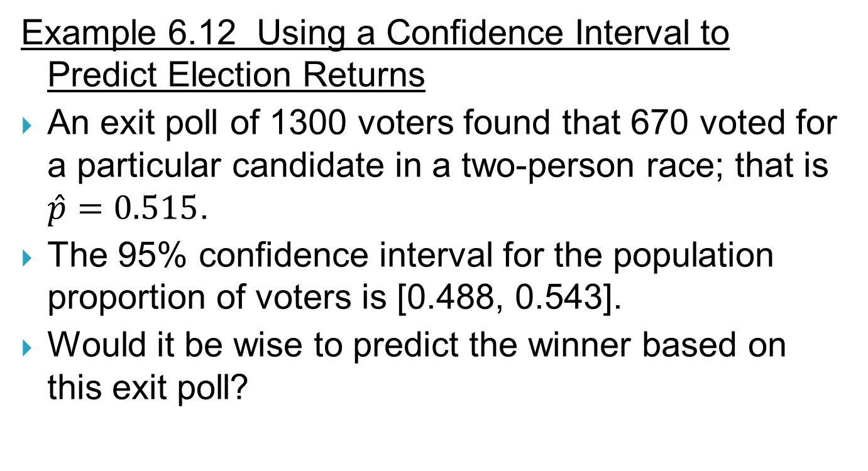
Using Confidence Intervals for Decision Making

Slide 39

Prediction Intervals
Computing a Prediction Interval
Confidence intervals estimate the value of a parameter such as a MEAN or PROPORTION.
Prediction intervals provide a range of values for a new OBSERVATION from the same population.
Prediction intervals are wider than confidence intervals.
Confidence interval:
Prediction interval:

Slide 40
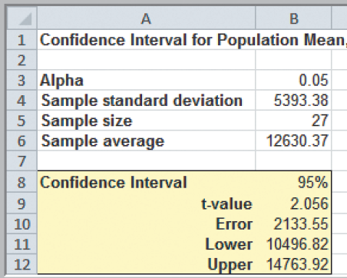
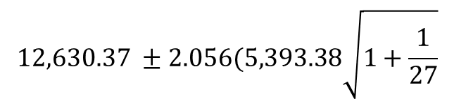




Confidence Intervals and Sample Size
Example 6.13 Computing a Prediction Interval
Compute a 95% prediction interval for the revolving balances of customers (Credit Approval Decisions)
From Example 6.9
Prediction interval width = 22,585
Confidence interval width = 4,267

Slide 41
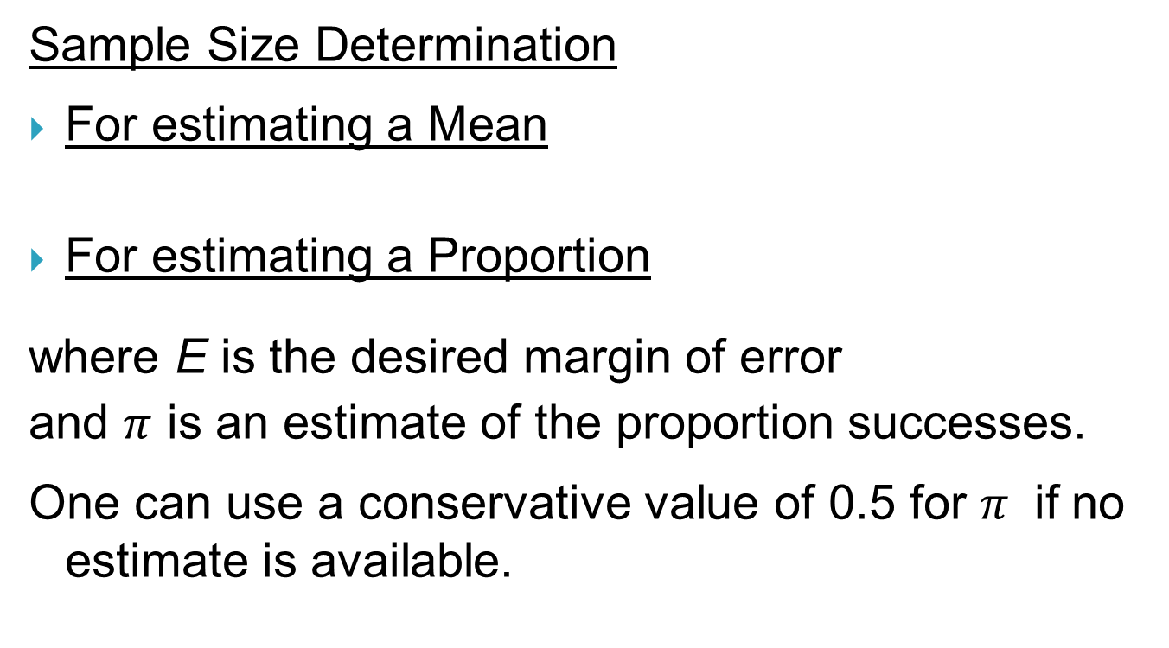


Confidence Intervals and Sample Size

Slide 42
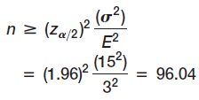

Confidence Intervals and Sample Size
Example 6.14
Sample Size Determination for the Mean
In the liquid detergent example, the margin of error was 2.985 mls.
What is sample size is needed to reduce the margin of error to at most 3 mls?
Round up to
97 samples.
Figure 6.11

Slide 43
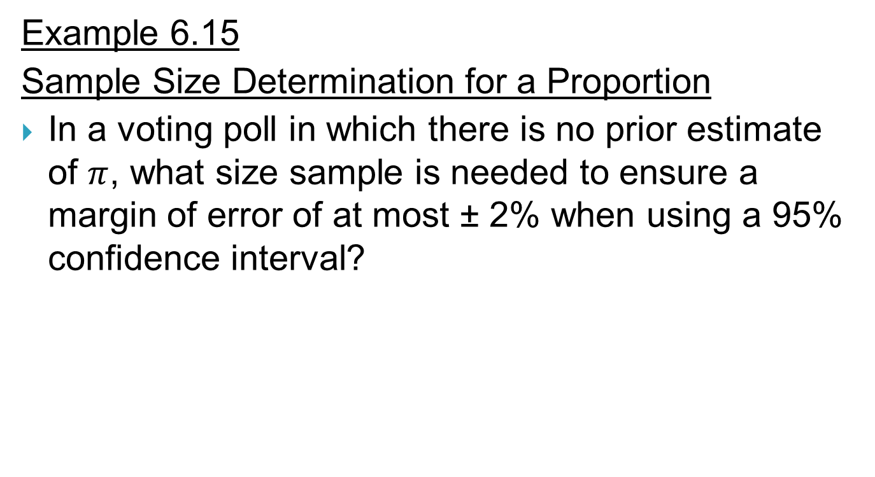
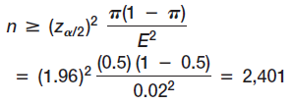
Confidence Intervals and Sample Size

Slide 44
Chapter 6 - Key Terms
Central limit theorem
Cluster sampling
Confidence interval
Convenience sampling
Degrees of freedom
Estimation
Estimators
Interval estimate
Judgment sampling
Level of confidence
Nonsampling error
Point Estimate
Population frame
Prediction interval
Probability interval
Sample proportion
Sampling (statistical) error
Sampling distribution of the mean
Sampling plan

Slide 45
Chapter 6 - Key Terms (continued)
Simple random sampling
Standard error of the mean
Stratified sampling
Systematic (or periodic) sampling
t-distribution

Slide 46


Case Study Performance Lawn Equipment (6)
Recall that PLE produces lawnmowers and a medium size diesel power lawn tractor.
Determine the probability a customer is highly satisfied for each geographic region.
Compute a confidence interval estimate of customer service response times.
Find the required sample size for a confidence interval estimate of blade weights.
Write a formal report summarizing your results.

Slide 47
